Slide 1

Project Title – Netflix Data Analysis
Chitrang Potdar
APPLY_175542719668a1b17ca9cfe

Slide 2

PROBLEM STATEMENT
Netflix is one of the leading global streaming platforms with a vast and diverse content library, but faces intense competition from services like Amazon Prime, Disney+, and regional OTT providers. To maintain its competitive edge, Netflix must analyze its content catalog strategically. The key challenge is to understand content trends over time — specifically, how the balance between Movies and TV Shows, genres, and country-wise contributions has evolved. Without such insights, it becomes difficult to identify strengths, gaps, and opportunities in content strategy.

Slide 3
Project Description
This project focuses on Content Trends Analysis of Netflix’s catalog (2008–2021) using a dataset of 7,789 titles across 11 attributes (title, director, cast, country, release year, rating, duration, type/genre, etc.).
The analysis was carried out through Exploratory Data Analysis (EDA) in Jupyter Notebook and an interactive Streamlit dashboard.
Key aspects include:
Movies vs. TV Shows distribution trends across years.
Genre analysis and shifts in popularity over time.
Country-wise contributions and global content expansion.
The project outputs data-driven strategic recommendations for Netflix to focus on high-growth genres and underrepresented regions, ensuring better audience engagement and competitive positioning in the global OTT market.

Slide 4

WHO ARE THE END USERS?
Netflix Content Strategy Team → to decide what type of shows/movies to produce or acquire.
Marketing & Regional Teams → to align campaigns with popular genres and regional preferences.
Data Analysts / Business Analysts → to explore content trends and generate deeper insights.
Investors & Management → to understand Netflix’s global growth strategy and market penetration.
Viewers (Indirectly) → benefit from better content curation aligned with their preferences.

Slide 5

Technology Used
Programming Language:
Python
Libraries for Data Analysis & Visualization:
Pandas → Data cleaning & manipulation
NumPy → Numerical computing
Matplotlib → Data visualization
Seaborn → Advanced statistical plots
Scipy→ For hypothesis and skewness analysis
Streamlit→ For creating web based dashboard
Tools/Environment:
Jupyter Notebook
Excel/CSV for dataset handling

Slide 6
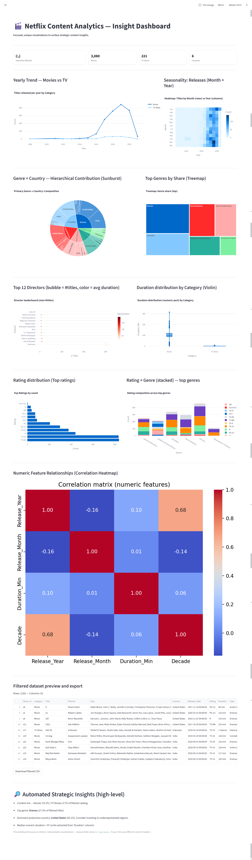
RESULTS1

Slide 7
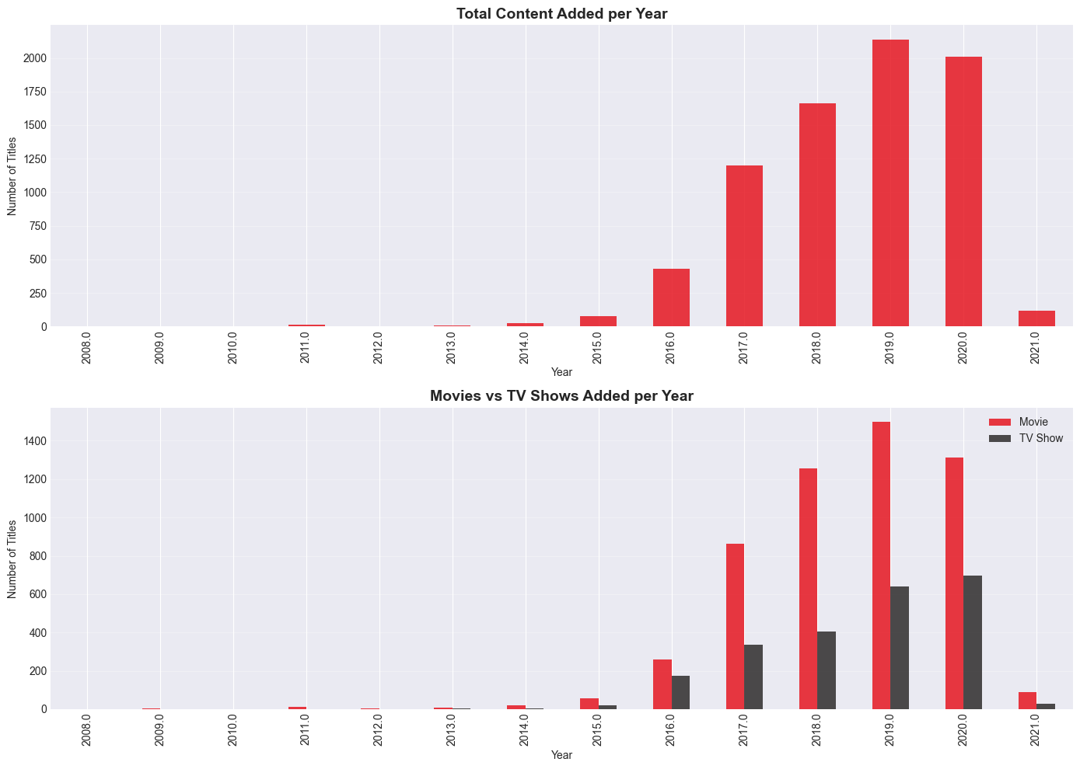
RESULTS2

Slide 8
RESULTS3

Slide 9
GitHub repository
https://github.com/Dev-Chitrang/VOIS_AICTE_Oct2025_MajorProject_ChitrangPotdar

Slide 10
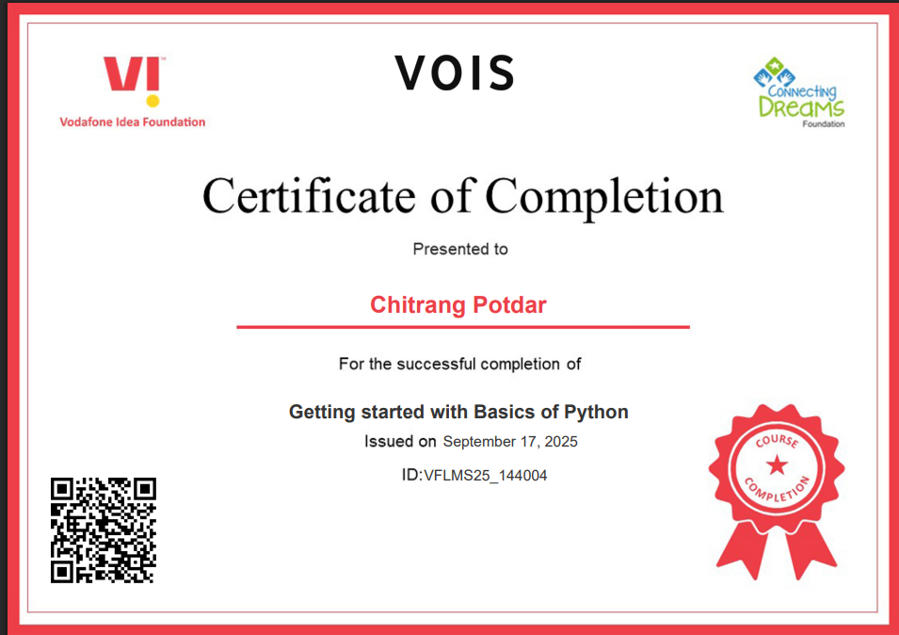
Getting started with Basics of Python Certificate

Slide 11
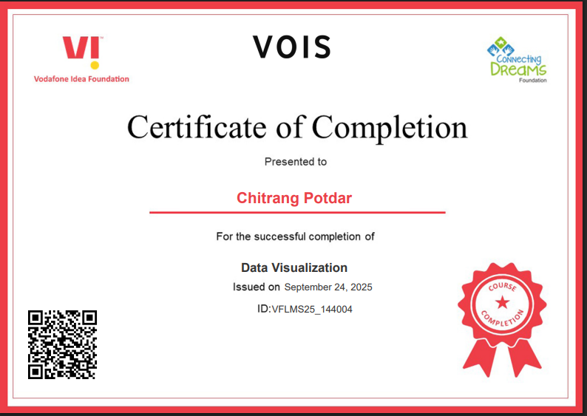
Data Visualization Certificate

Slide 12
Thank you
.
.

